Slide 1
An Introduction to the R Programming Language
Lesson 6
Statistics

Slide 2
Objectives
Be able to…
Calculate basic statistical calculations for groups within a data set
Use standard statistical modeling functions
Compare variables’ distributions

Slide 3
Typical Data Science Pipeline
From R for Data Science (https://r4ds.had.co.nz/introduction.html)
Notes:
In this session we will focus on modeling. But, in the process, we will do more data transformation

Slide 4
Q: Are the number of orders per patient different in Internal Medicine and Family Medicine?

Slide 5

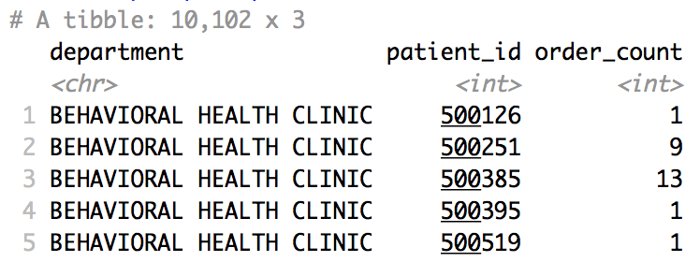
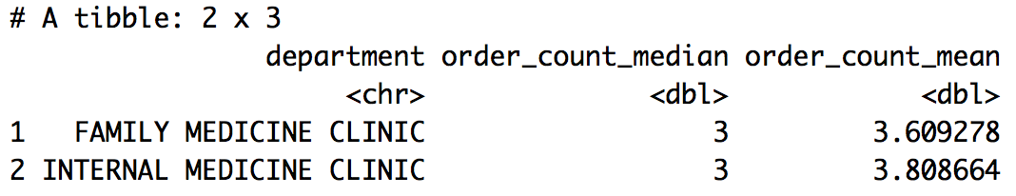
Describe the central tendency of the order count
orders %>%
group_by(department, patient_id) %>%
summarize(order_count = n()) %>%
summarize(order_count_median = median(order_count),
order_count_mean = mean(order_count)) %>%
filter(department %in% c("INTERNAL MEDICINE CLINIC",
"FAMILY MEDICINE CLINIC"))
1
2
1
2
Notes:
As in the previous section, we tabulate the number of orders for each distinct department-patient_id combination and then summarize within each department.

Slide 6
Basic statistics functions
Central Tendency and Variability
Function | What it Calculates
mean(x) | Mean of the numbers in vector x.
median(x) | Median of the numbers in vector x
var(x) | Estimated variance of the population from which the numbers in vector x are sampled
sd(x) | Estimated standard deviation of the population from which the numbers in vector x are sampled
scale(x) | Standard scores (z-scores) for the numbers in vector x
https://www.dummies.com/education/math/statistics/base-r-statistical-functions/

Slide 7
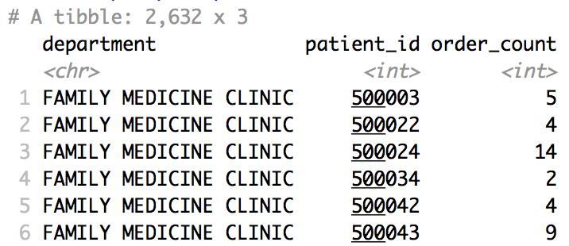
Prep: Order count per patient for each department
orders_per_pt_dept <- orders %>%
group_by(department, patient_id) %>%
summarize(order_count = n()) %>%
ungroup() %>%
filter(department %in% c("INTERNAL MEDICINE CLINIC",
"FAMILY MEDICINE CLINIC"))
1
2
2
1
Notes:
We tabulate the number of orders for each distinct department-patient_id combination.
Note, we must call `ungroup()` to remove the residual group – we grouped by two variables, but only summarized once.

Slide 8
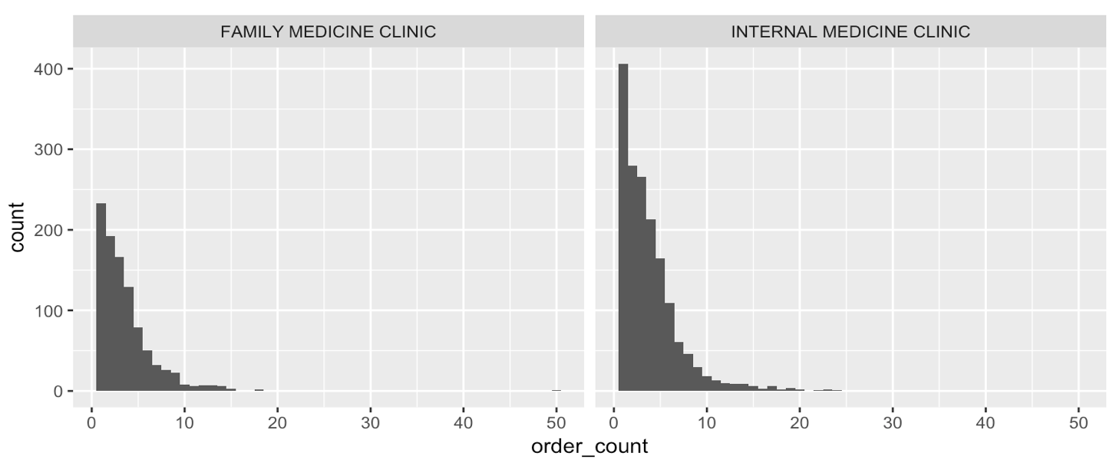
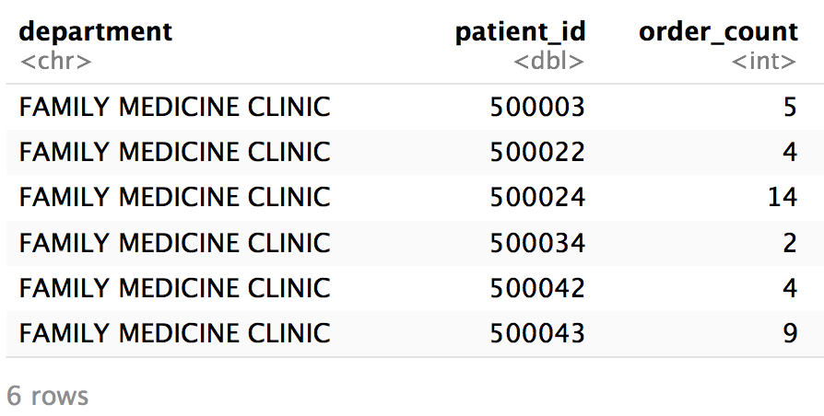
Visualize the distribution of order counts
orders_per_pt_dept %>%
<insert ggplot code>
orders_per_pt_dept
Notes:
We can plot a histogram using ggplot. We will learn how to do this later, but the code used is:
orders_per_pt_dept %>%
ggplot() +
geom_histogram(aes(x = order_count), binwidth = 1) +
facet_wrap(~department)
Note, here it could be informative to log-scale the axes or plot departments separately.
Order_count appears to not be normally distributed. There is a large right or positive skew. We could quantify the rightward skew in this population using the skew() function in the packages `psych` or `e1071`. A right-skewed distribution is very common for count variables, as well as many lab test results for which low values are much more common than higher values.

Slide 9
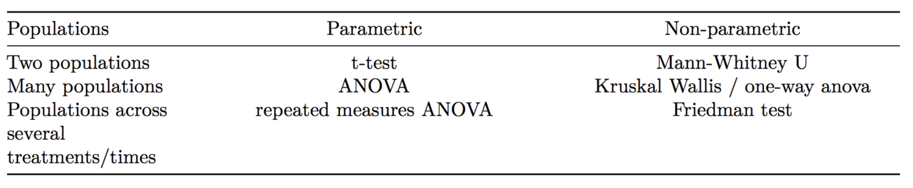
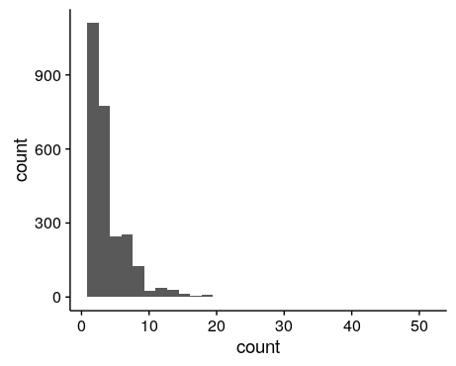
What test can compare count distributions?
Notes:
R has functions for common statistical tests

Slide 10
wilcox.test()
dependent or outcome variable
tilde operator
grouping or predictor variable
wilcox.test(measure ~ group,
data = orders, ...)
additional arguments
data frame
Compare distributions by rank order
Notes:
Mann-Whitney U-test or Wilcoxon rank-sum test evaluates the null hypothesis that a randomly sampled value from group 1 is equally likely to be greater than or less than a randomly sampled value from group 2. It tests whether the distribution of values in each group is the same

Slide 11
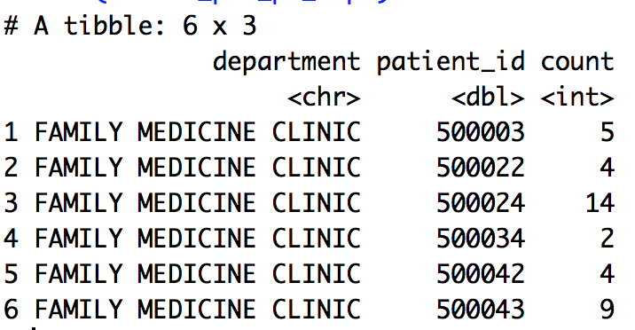
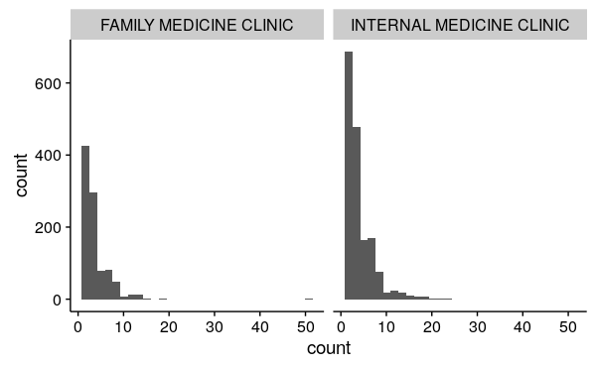
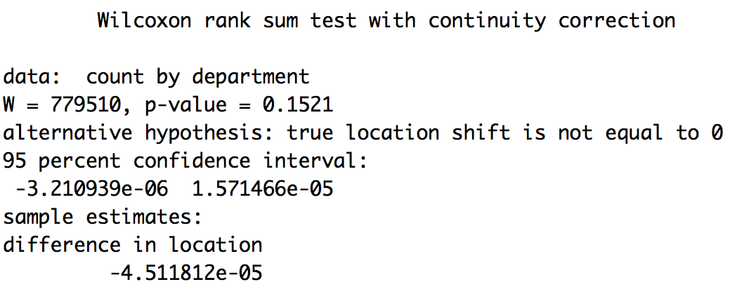
Compare order count distributions between 2 departments
orders_per_pt_dept
Wilcoxon rank-sum test
wilcox.test(order_count ~ department,
data = orders_per_pt_dept,
alternative = "two.sided",
paired = FALSE,
conf.int = TRUE)
Notes:
Interpretation: Results do not provide evidence for a difference in the number of tests ordered per patient between these two departments. P-value is not significant. Effect size estimate is very low (-4 x10^-5)

Slide 12
Objectives
Be able to…
Calculate basic statistical calculations for groups within a data set
Use standard statistical modeling functions
Compare variables’ distributions

Slide 13
What Else?

Slide 14
Q: Can we predict the number of orders for each department in September?

Slide 15
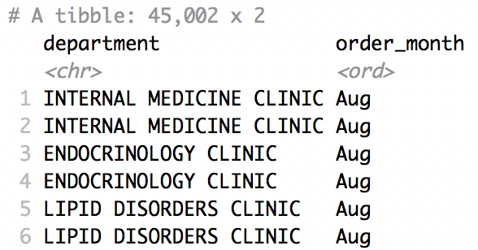
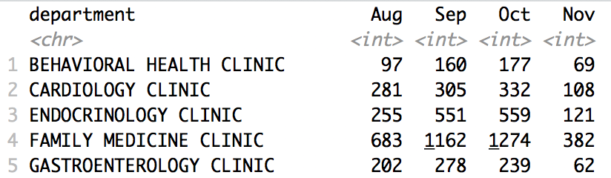
Prepare: Order per month for each department
orders_per_pt_dept <- orders %>%
mutate(order_month = month(order_time, label = TRUE, abbr = TRUE)) %>%
group_by(department, order_month) %>%
summarize(order_count = n()) %>%
ungroup() %>%
spread(key = order_month, value = order_count)
1
2
2
1
Notes:
We tabulate the number of orders for each distinct department-patient_id combination. Note, we must call `ungroup()` to remove the residual group – we grouped by two variables, but only summarized once.

Slide 16
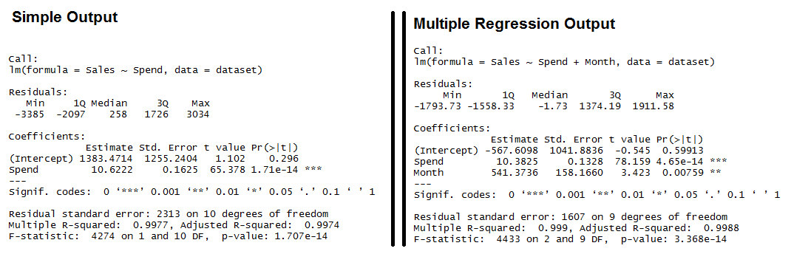
Simple linear regression modeling
model <- lm(formula = y_data ~ x_data, data = data_set)
summary(model)
coef(model)

Slide 17
Your Turn 1
a) Use linear regression to predict departments’ October order counts using September order counts
b) (*Bonus*) Use deming regression to compare Oct and Sep order counts
*HINT*: Look at library “mcr”
c) (*Bonus*) Try to improve the linear regression prediction by adding more predictors

Slide 18
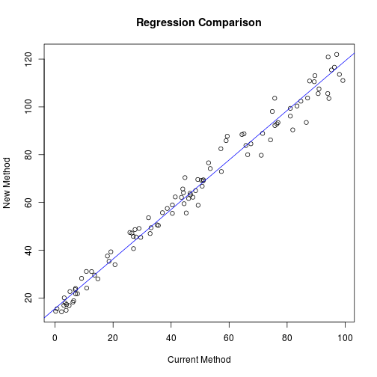
Method comparison regression package for more advanced regression options
install.packages(“mcr”)
library(mcr)
model <- mcreg(x_data, y_data, method.reg = “Deming”) printSummary(model)
getCoefficients(model)
https://www.r-bloggers.com/deming-and-passing-bablok-regression-in-r/

